Slide 1

SLW Home Improvements
Members
Carson Hatem – Systems Analyst
Austin Bing-Zaremba – Business Analyst
Christian Lancaster – Co-Product Owner
Jackson Ingalls – Database/Programming Coordinator

Slide 2
Business Description
SLW Home Improvements is a company specializing in fabrication
Based in Greenville, North Carolina
Currently manages most customer data, pricing, and services manually
Looking to improve operations with a digital solution

Slide 3
Business History
Started in 2008 in Greenville, North Carolina
Business is owned by Scott Wallace
SLW Home Improvements only has 3 current employees

Slide 4
Current Business Environment
Uses manual processes for customer management
Most business transactions are completed over the phone or by email
No centralized system for tracking requests from customers or pricing
Very limited digital presence resulting in suboptimal new customer attraction/acquisition (no website currently)
Prone to inefficiencies and delays in workflow due to no system in place

Slide 5
Why this Project was Chosen
This is a local small business that we all agreed we would like to help
This business needs a digital solution to improve both efficiency and accuracy
A database and website will streamline both business operations and customer interaction
Improving the company’s online presence will result in business growth
The automation of processes will reduce errors and improve efficiency

Slide 6
Current System Problems
There is no automation within the current system
Manual data entry leads to both errors and inefficiencies
Difficulty in tracking customer service requests and service history
No simple way for customers to request services or get quotes online
Limited accessibility of business information

Slide 7
Proposed System and Objectives
Develop a user-friendly website for customer engagement
Implement a secure database to store customer data and pricing data
Improve data management with easy access to those who need it
Enhance customer interactions by creating a way to send online service requests

Slide 8
Functional Requirements
Service Listings – Customers must be able to view services and pricing
Request a Quote – Customers must be able to submit a form to request quote
Customer Database – Database must store customer details and requests
Admin Panel – Owner must be able to update services, pricing, and requests
Confirmation Messages – Customers must receive confirmation after sending request

Slide 9
Non-functional Requirements
Ease of Use – The website needs to be simple and user friendly
Speed & Reliability – Pages should load quickly, and system should have minimal downtime
Security – Customer data should be protected with encryption
Scalability – The system should support future growth and new features
Maintainability – The system should allow for easy updates

Slide 10
Constraints
Limited budget and timeline for project implementation (12 weeks broken up into 6 sprints)
We must ensure that data security is a priority to protect sensitive customer information
System implementation with the existing processes must be smooth
System must be easy to use for both employees and customers

Slide 11
Expected Benefits
Increased efficiency by reducing manual work
Enhanced customer satisfaction by optimizing communication and visibility
Improved data accuracy and organization resulting from a central system being implemented
Stronger online presence to attract and maintain customers

Slide 12
Problem Analysis (BPA)
This project is mostly BPA (Business Process Automation)
We are taking manual processes (pricing, service requests, etc.) and automating them
Employees will do the same core tasks, just in a newly automated way
Some BPR elements involved in the project (website creation and online requests)

Slide 13
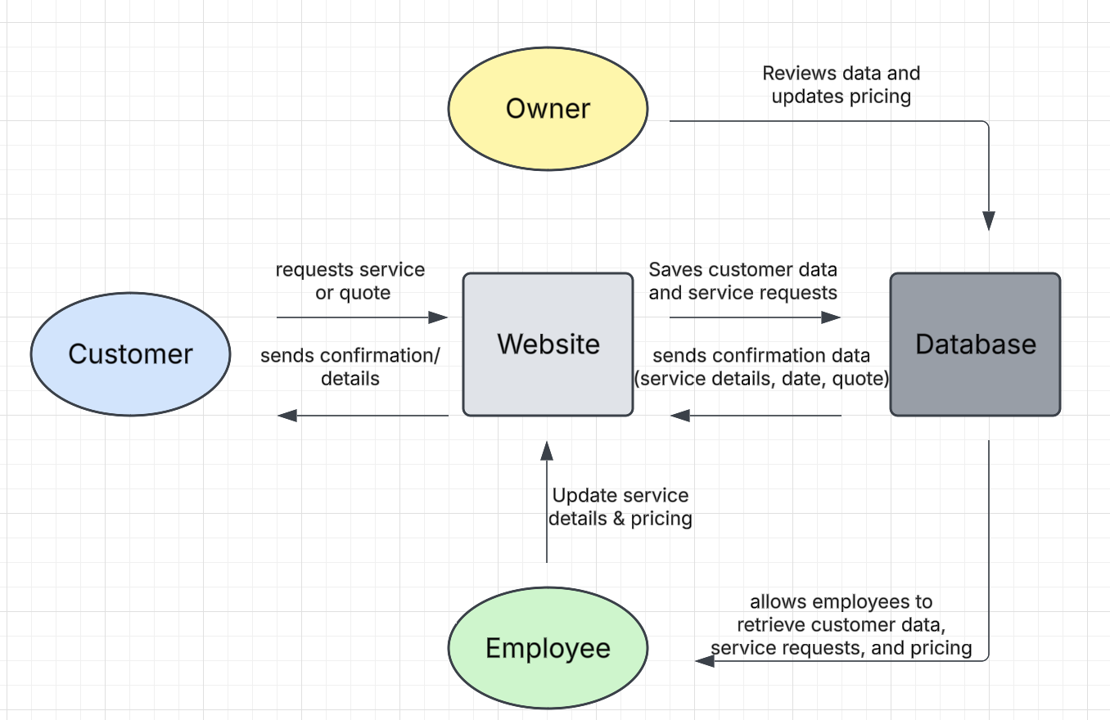
Context Diagram

Slide 14
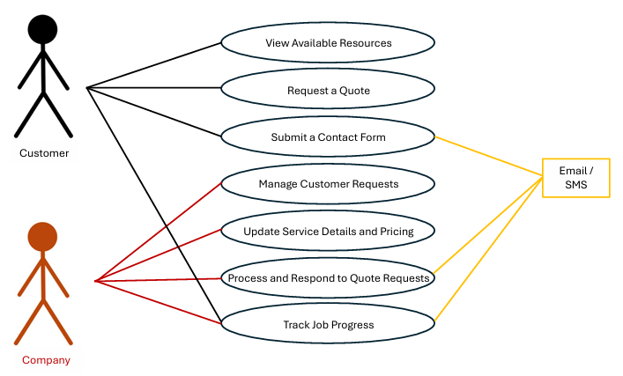
Use Case Diagram

Slide 15
Product Backlog
PROJECT PRODUCT BACKLOG |  |  |  | Assignment
UR# | Item | Priority | Status | Team Member | Sprint
1 | Define Project Scope and Objectives | High | Completed | Austin | 1
2 | Identify Systems Requirements | High | Completed | Carson | 1
3 | Develop Context Diagram & Use Case Diagram | High | Completed | Christian | 1
4 | Identify Key System Users | Medium | Completed | Jackson | 1
5 | Research Potential Security Risks | Medium | Completed | Jackson | 1
6 | Design the ERD | High | OPEN | Jackson | 2
7 | Create Database Schema | High | OPEN | Christian | 2
8 | Implement User Authentication | High | OPEN | Austin | 2
9 | Optimize Query Performance & Indexing | Medium | OPEN | Carson | 2
10 | Develop Homepage | High | OPEN | Austin | 3
11 | Create Customer Registration | High | OPEN | Jackson | 3
12 | Implement Request a Quote form | Low | OPEN | Carson | 3
13 | Design Dashboard | Medium | OPEN | Austin | 3
14 | Ensure Mobile Responsiveness | Low | OPEN | Christian | 3
15 | Develop Customer Retrieval System | High | OPEN | Jackson | 4
16 | Implement Pricing Calculation | Medium | OPEN | Austin | 4
17 | Set up automated email confirmations | Low | OPEN | Carson | 4
18 | Develop logging system for errors | Low | OPEN | Christian | 4
19 | Conduct unit testing on database & frontend | High | OPEN | Jackson | 5
20 | Deploy system to live server | High | OPEN | Carson | 5
21 | Monitor and Resolve Deployment Issues | High | OPEN | Austin | 5
22 | Create user manual | High | OPEN | Christian | 5
23 | Develop training materials | High | OPEN | Austin | 6
24 | Develop System Architecture | High | OPEN | Jackson | 6
25 | Conduct Training Sessions | High | OPEN | Carson | 6

Slide 16
Sprint 1 Backlog
SPRINT 1 BACKLOG |  |  |  | Assignment
UR# | Item | Priority | Status | Team Member
1 | Define Project Scope and Objectives | High | Completed | Austin
2 | Identify Systems Requirements | High | Completed | Carson
3 | Develop Context Diagram & Use Case Diagram | High | Completed | Christian
4 | Identify Key System Users | Medium | Completed | Jackson
5 | Research Potential Security Risks | Medium | Completed | Jackson

Slide 17
Sprint 1 Burn Down Chart
Backlog Item ID | User Stories / Requirements / Bugs | Estimated Time | Day 1 | Day 2 | Day 3 | Day 4 | Day 5 | Day 6 | Day 7 | Day 8 | Day 9 | Day 10 | Day 11 | Day 12 | Day 13 | Day 14 | Team Member | Total Time
1 | User Login System | 8 | 1 | 1 | 1 | 1 | 1 | 1 | 1 | 1 | 0 | 0 | 0 | 0 | 0 | 0 | Christian | 8
2 | Database Setup | 10 | 2 | 2 | 2 | 2 | 2 | 0 | 0 | 0 | 0 | 0 | 0 | 0 | 0 | 0 | Austin | 16
3 | UI Design | 12 | 2 | 2 | 2 | 2 | 2 | 2 | 0 | 0 | 0 | 0 | 0 | 0 | 0 | 0 | Jackson | 12
4 | API Development | 14 | 2 | 2 | 2 | 2 | 2 | 2 | 2 | 0 | 0 | 0 | 0 | 0 | 0 | 0 | Carson | 14
5 | Testing & Debugging | 6 | 1 | 1 | 1 | 1 | 1 | 1 | 0 | 0 | 0 | 0 | 0 | 0 | 0 | 0
Total Team Time | 50 | 8 | 8 | 8 | 8 | 8 | 6 | 3 | 1 | 0 | 0 | 0 | 0 | 0 | 0 | - |  | 50

Slide 18
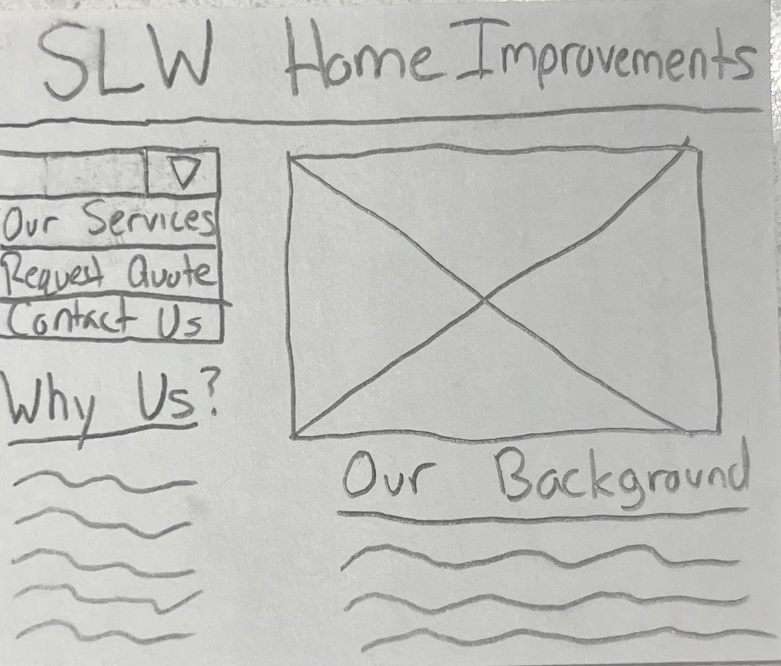
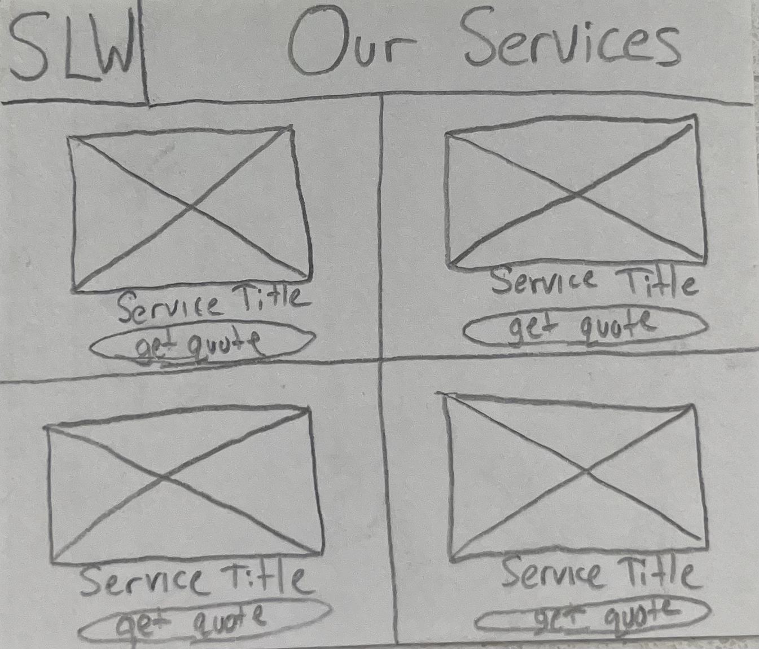
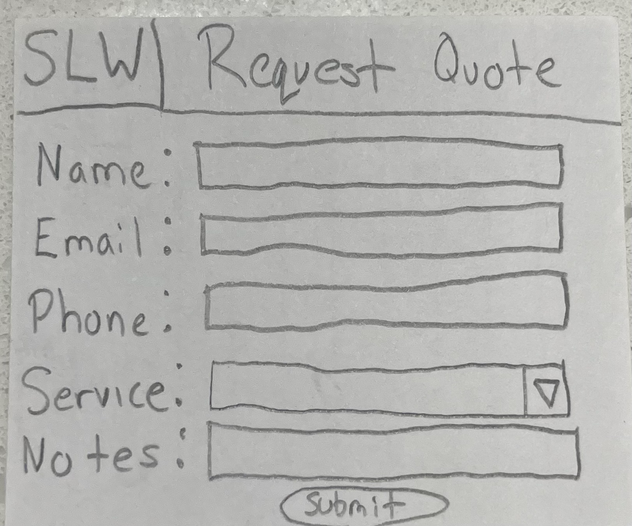
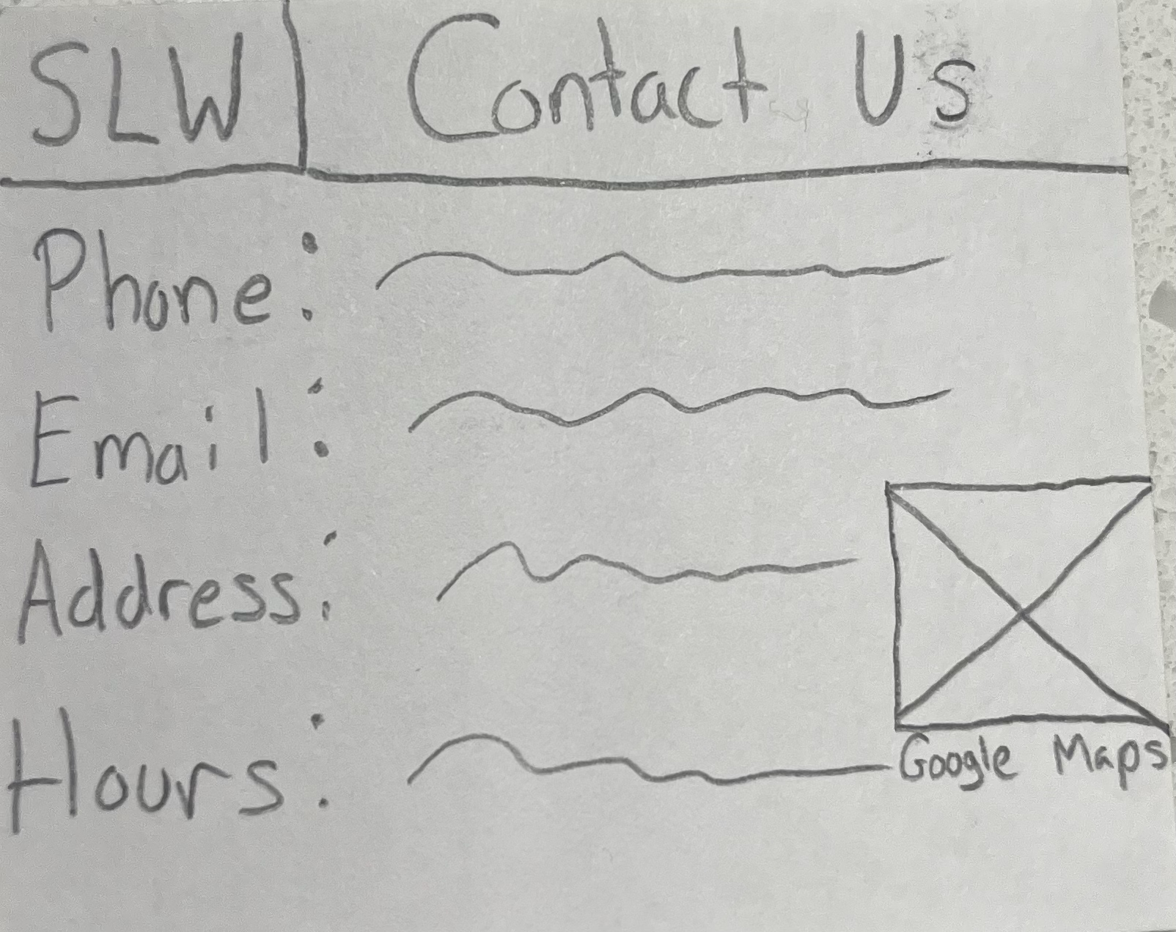
Sprint 1 PSPI
Home Page
Our Services Page
Request Quote Page
Contact Us Page

